Slide 1
Results from a pure GLM
Basic regression analysis (economic style)

Slide 2
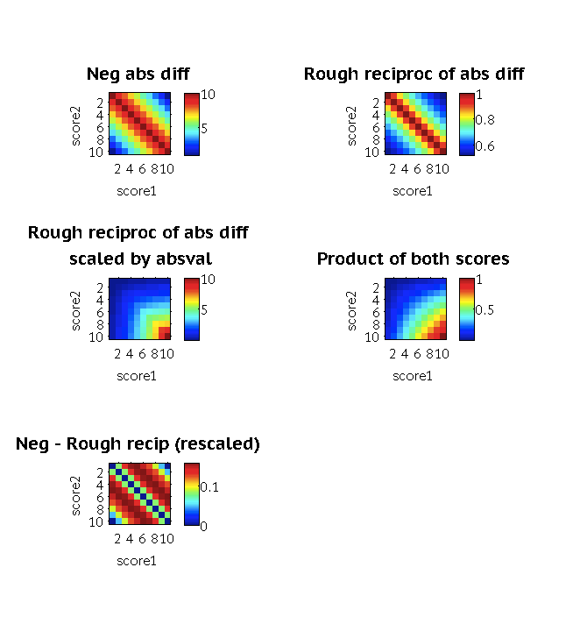
Operationalization of within-attribute ‘conflict’
Chosen option: max - abs diff (simplest, well spaced across range)
One could scale by the product of both scores, w the hypothesis that the ‘emotional’ conflict should also intrinsically depend on stakes (i.e. cf(10 vs 10 ) > cf(3 vs 3)
Rough reciprocal of abs diff is also an option – differs from max-absdiff subtly at the middle values

Slide 3
Analysis details
Session 2 (fMRI)
Data scooped from excel sheets
Note: Matlab files apparently have some coding errors, which Phoebe has corrected in the excel files only)
Conflict scores are linearly re-scaled to match range of PL/PP diff scores (-9:9)
RT data: all points >2SD away is always removed, log-transformed
Generally, difference scores are Opt1-Opt2.
For RT data, this is flipped when Opt 2 is chosen.
Conflict scores are not flipped in this way, because they are choice invariant (at least in their current formulation)
Results reported here have not had PL regressed out of PP. Running the GLMs on the PP-residuals is not productive.
Task setup details
Algorithm for creating shuffled matches still unclear – need to ask Robb
Apparently in file 'wellbeing_goodshuffle_inout.mat’

Slide 4
Fixed effects
Choice is affected by pleasure difference, RT is affected by pleasure diff & purpose conflict
Details
N_subjs categorical subject regressors
Note: if a single subject reg is used, PP diff also has a highly sig pos effect on RT. PP cf effect on RT remains
 | Choice | RT
PL diff | B =0.4162 (p<.001) | B=-0.0045, p=.005
PP diff
PL cF
PP cF |  | B=.003, p<.001

Slide 5
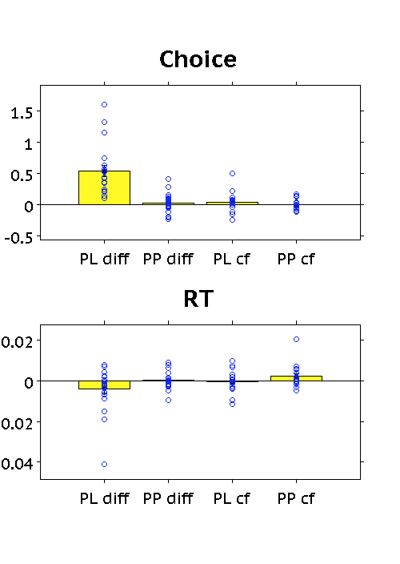
Mixed effects
Val diff in Pleasure domain affects choice, val conflict in the purpose domain affects RT
Note: p19’s PP cf beta on RT is an outlier (>3SD from mean). Removal leaves a statistical trend (p=.0543), use of a Wilcoxon signed rank test is still sig (p=.043)
Note: This may all have been a bug, but z scoring (rather than log-transforming) it will produce these efects
 | Choice | RT
PL diff | *** p=8.76e-06
PP diff
PL cF
PP cF |  | p=0.0491

Slide 6
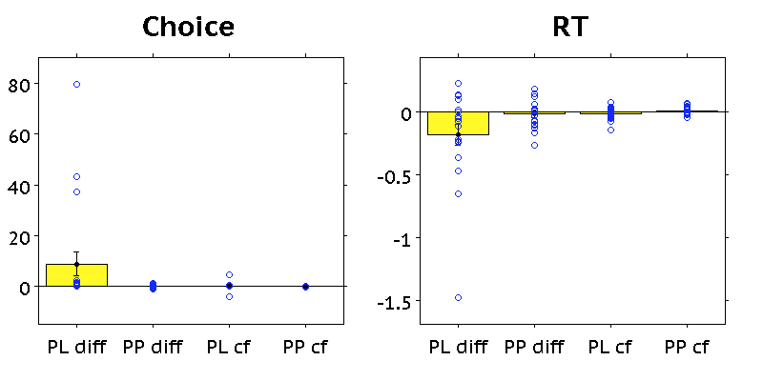
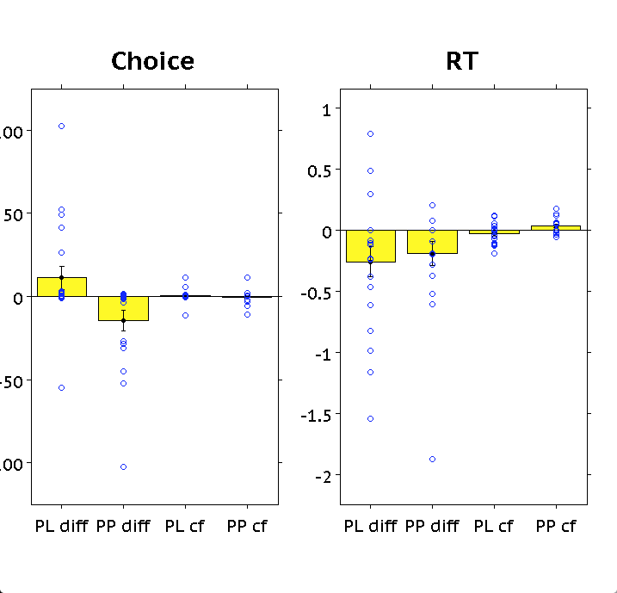
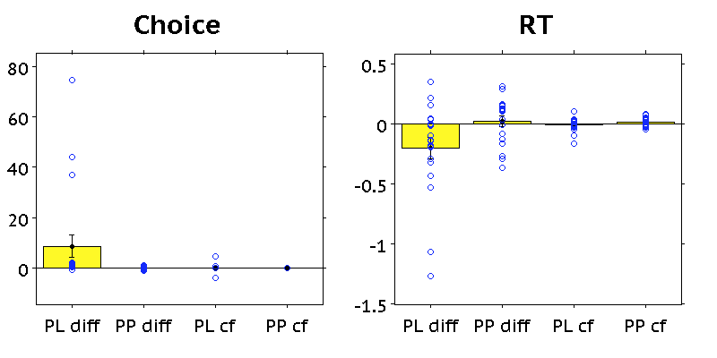
Regressions run on binned scores (b3)
P=.0678
P=.0694
P=.0454
Compatible Choice trials
Incompatible choice trials
P=.0629
P=.0665
P=.0325
P=.0254
P=.0486
P=.0957
P=.0189
Notes:
RTs are zscored

Slide 7
RT Preprocessing options

Slide 8
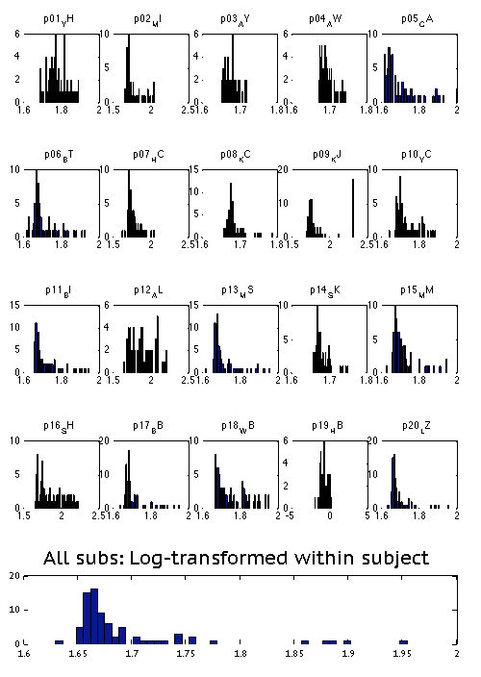
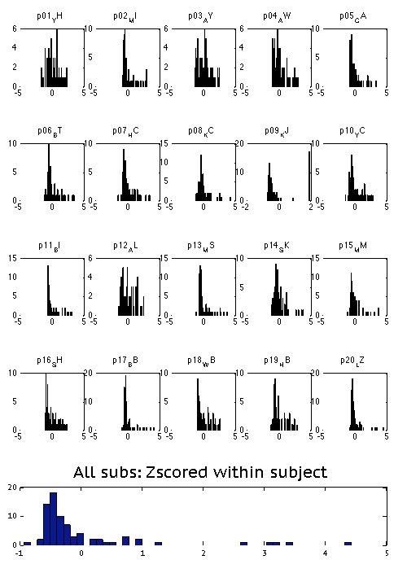
RT preprocessing?

Slide 9
